Slide 1
Carolingian Renaissance

Slide 2
Vocabulary
Required – požadovaný
Implement – uskutečnit
Commited – odevzdaný
Exclude – vyloučit
Skirmish – šarvátka
Marks – marky
Manuscript - rukopis
Struggled to achieve – snažil se dosáhnout
Establish – založit
Occupied himself with – zabýval se
Duke – vévoda
Envoy – velvyslanec

Slide 3
Charlemagne’s reforms
Government and administration
Education
Literature

Slide 4
Counties
Frankish Empire – larger and larger
Divited into counties
Governed by counts
Counts – appointed by the kings
Counts - pledge of loyalty and military service

Slide 5
Marks
= border areas with a different system of government
Under the threat of attack
Internal skirmishes
Required constant military presence
Governed by margraves or dukes
Supervised by royal envoys

Slide 6
Reform of education
Better education for clerks
Establishment of church and monastic schools
Focus on reading and writing
One of such schools – at Charlemagne’s court
Important teacher – Alcuin of York

Slide 7
Carolingian minuscule
Developed as a calligraphic standard in Europe
Used in the Holy Roman Empire
Roman half uncial and the insular scripts
Partly created under the patronage of the Emperor Charlemagne

Slide 8
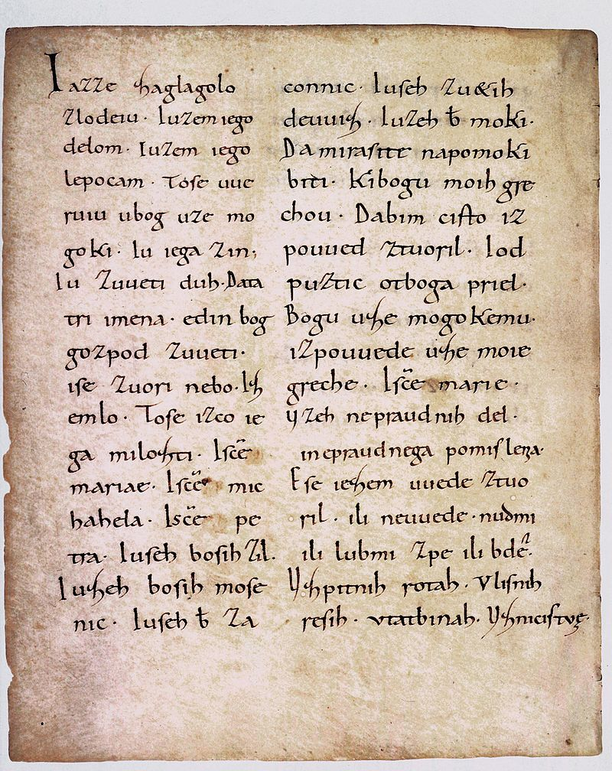
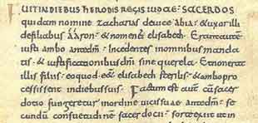

Slide 9
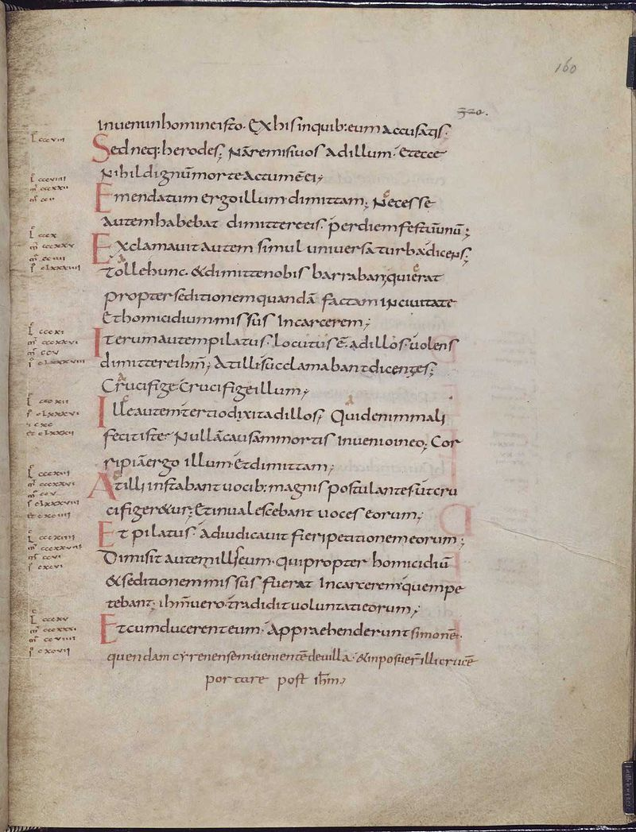

Slide 10
Alcuin of York
In York – library with many manuscripts
Charlemagne – invitation to come to Aachen to design a curriculum for the palace school
Course of study – to train the clergy and the monks
Teacher – important role in the cultural and educational revival

Slide 11
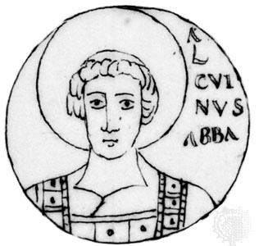

Slide 12
Thank you for attention.
Ponerová and Kopecká

