Slide 1
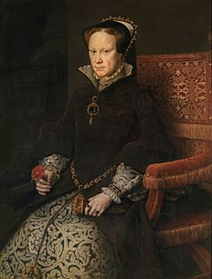
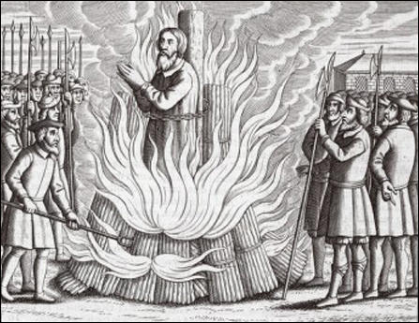
MARY TUDOR BLOODY MARY
Kristýna Flekalová a Petra Muchová

Slide 2
Who was she?
Queen of England and Ireland since 1553
The only child of Henry VIII
Wife of Philip II of Spain
Attemp of catholic reformation

Slide 3
Mary and protestants
284 protestants were burnt because of their beliefs
People have to attend mass again
Statues, stone altars, prayers to virgin Mary
Authority of the Pope over religion in England
Lutherans Latimer and Ridley – Oxford 1555
John Fox – book
Preachers and writers fled to Germany and Switzerland

Slide 4
Mary and Philip II of Spain
People in England were scared of Mary having a child
Spanish king was cruel towards protestants
People were executed – their courage inspired other to become protestanst
Because of Mary‘s cruel ways Catholic faith had a bad reputation
Southern England

Slide 5
Bloody Mary or not?
She was cruel but the others were too
People were hanged, drawn and quartered – Catholicism
Tudor age was cruel period of English history

Slide 6
Succesor
Her reign ended in 1558
Ill health
Failed to have a baby

