Slide 1
Undefeatable Armanda
Dominik Doubrava
Ondřej Cieslar
František Hájek

Slide 2
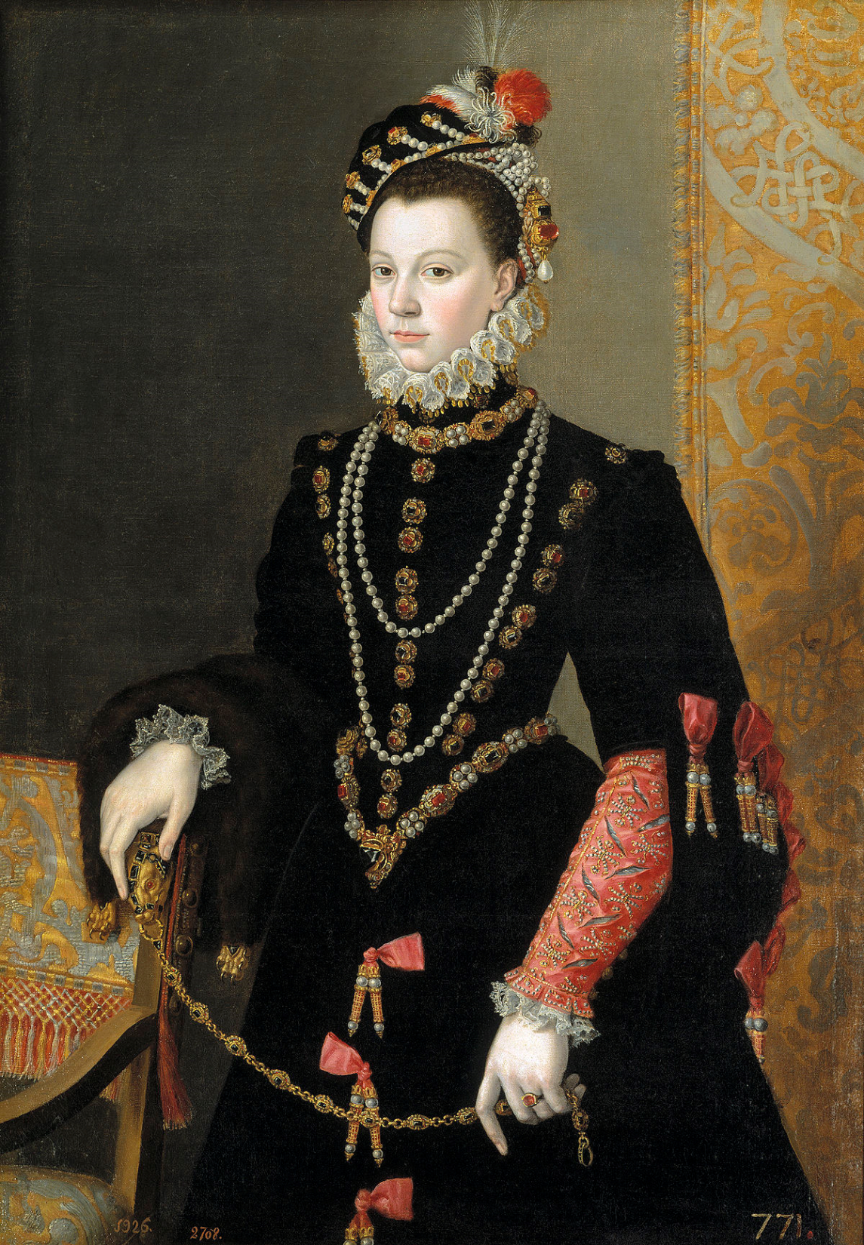

Slide 3
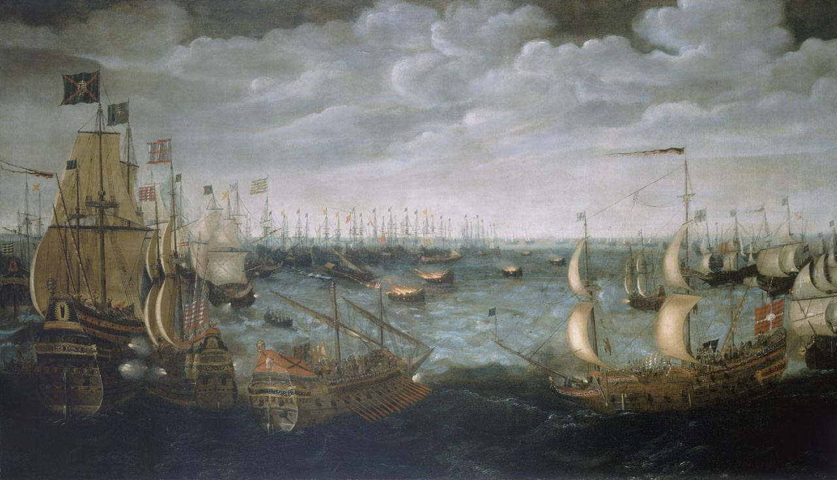
The Catholic Spanish King Phiph II, the most powerful ruler in Europe, want to conquer Protestant England. He built a Grande y Felicísima Armada "Great and Most Fortunate Navy" also known as undefeatable Armada.
France joined Spain to get Calais last British holding in France.

Slide 4
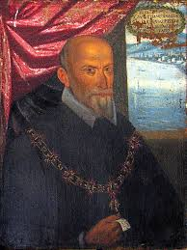
The Battle
The fleet sailed from Lisbon (28.may 1588) to Chanel Lamenche, but they take heavy losses due to bad weather, problems with food and water and also drake's attack in Cadiz.
The undefeatable army was defeated by English commander Charles Howard in the battle of Gravelings (8. June 1588) with the use o fire ships.
The Spanish escape Nord. where they took heavy losses while they were sailing around Scotland and Ireland.
The commander of the navy was supposed to be general Santa Cruz, but he died before the invasion. He was replaced by not so good commander Duke of Medina Sidonia.

Slide 5
English men
On the other sides, there was experience Admiral Charles Howard and great corsairs Francis Drake and John Hawkins.
England sailors were also more competent than Spanish army trained to fight on the ground.

